Slide 1


NEXT GEN EMPLOYABILITY PROGRAM
CREATING A FUTURE-READY WORKFORCE
Student Name :
Vaishnavi Ghatge
Student ID :
STU63724f65df9f61668435813
Mobile No:
9356320950
Mail ID:
vaishnavighatge77@gmail.com
College Name :
AISSMS Institute of Information Technology

Slide 2
CAPSTONE PROJECT SHOWCASE
Project Title
Power BI Enabled Comprehensive Analysis on Unicorn Businesses
Abstract | Problem Statement | Project Overview | Proposed Solution | Technology Used | Modelling & Results | Conclusion | Q&A

Slide 3
Abstract
1
Analyze unicorn company’s geographical distribution and funding trends using Power BI, integrating data on company name, location, funding, industry, and key investors.
2
Visualize unicorn company’s growth trajectories over time, correlating valuation with funding amounts and industry sector using Power BI's dynamic dashboard features.
3
Explore the relationship between unicorn company’s founding years, valuation, and continent-wise presence through interactive Power BI charts and filters.
4
Conduct comparative analysis of unicorn companies across continents, examining funding sources, industry diversity, and valuation metrics leveraging Power BI's comprehensive data visualization capabilities.

Slide 4


Problem Statement
Determine the average number of years it takes for a company to transition into an unicorn.
Determine the continent with the highest number of unicorns.
Discovered which country hosts the highest number of unicorns.
Determine the year that generated the highest number of unicorns.
Identify the industry with the highest number of unicorns.
Identify the company with the highest Return on Investment (ROI).
Identify the investor who funded the majority of the unicorns.
Discovered the year in which a unicorn company generated the highest valuation.
Identify the industry with the highest amount of funding.

Slide 5

Project Overview
In the initial stage, data collection, cleaning, and pre-processing were conducted to ensure the reliability and integrity of the datasets.
The second stage involved the application of DAX functions and basic visualization techniques to compute key metrics and visualize trends within the unicorn company data.
The third stage focused on enhancing visualization techniques to present insights effectively, aiding stakeholders' understanding of critical patterns and trends.
Finally, the fourth stage comprised formatting the visualizations for clarity and conducting rigorous testing to validate the accuracy and reliability of the analysis, ensuring its suitability for strategic decision-making.

Slide 6
Proposed Solution
I have utilized Power BI Dashboard to analyze the project.
I have determined the average duration it takes for a company to transition into a unicorn using card visual.
I have identified the continent boasting the highest number of unicorn using pie chart.
I have discovered which country hosts the highest number of unicorns using map visual.
I have determined the year that generated the highest number of unicorns using area chart.
I have uncovered the industry with the highest number of unicorns using stacked bar chart.
I have identified the company with the highest Return on Investment (ROI) using matrix chart.
I have determined the investor who funded the majority of the unicorns using clustered column chart.
I have identified the year in which a unicorn company achieved the highest valuation using line chart.
I have discovered the industry with the highest amount of funding using treemap visual.

Slide 7
Technology used
Power BI

Slide 8
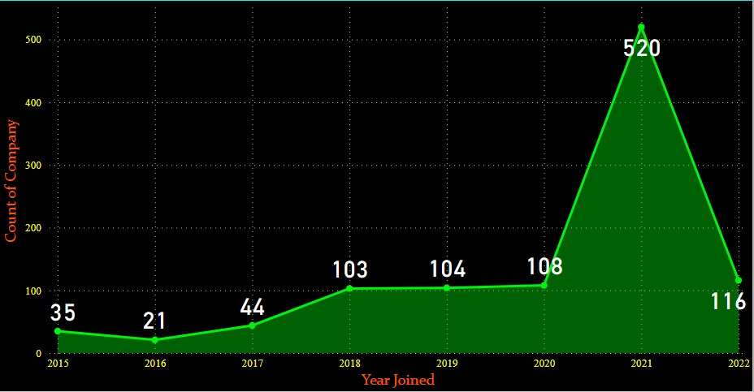
Modelling & Result
The stacked column chart visualizes the years when the maximum number of companies became unicorns, revealing that 2021 had the highest count.
I applied advanced filtering, which includes years greater than or equal to 2015, for convenience.

Slide 9
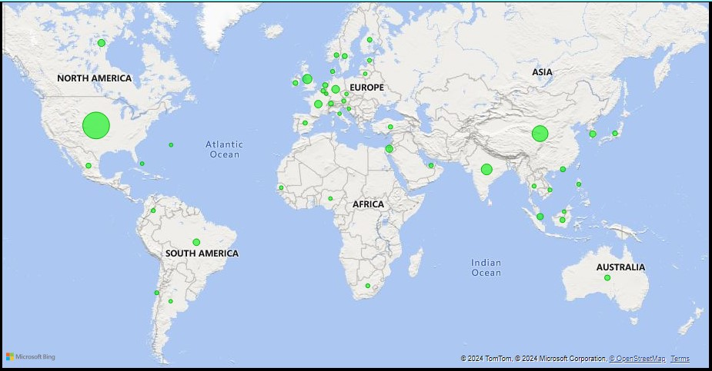
Modelling & Result
I utilized a map visual to ascertain the country with the highest number of unicorns.
The visual indicates that the United States boasts the highest number of unicorns, while Senegal has the fewest.

Slide 10
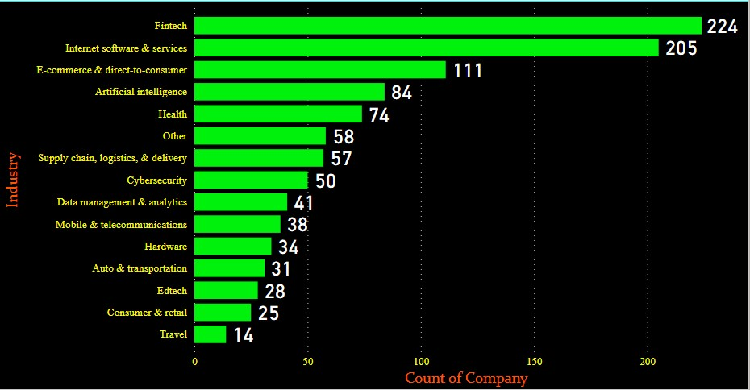
Modelling & Result
When creating a stacked bar chart for the count of companies by industry and enabling data labels, it's evident that the Fintech industry has the highest number of unicorns, while the Travel industry has the least number of unicorns.

Slide 11
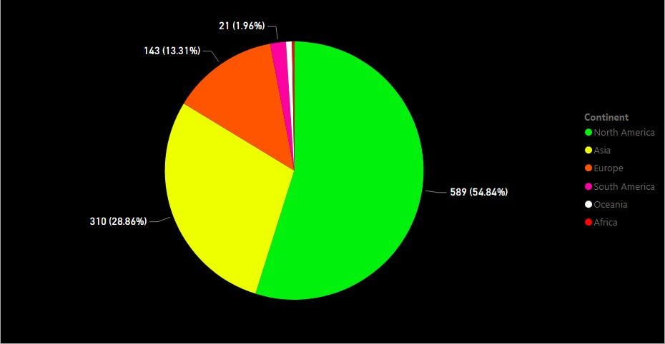
Modelling & Result
I utilized a pie chart to ascertain the continent that accommodates the highest number of unicorns.
This visual indicates that North America boasts the highest number of unicorns, while Africa has the fewest.

Slide 12
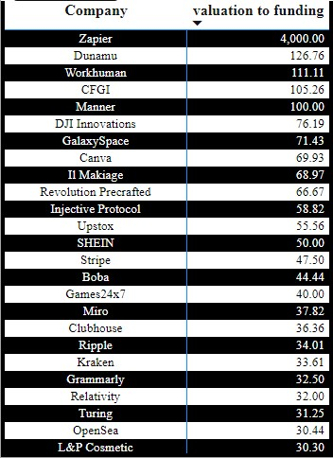
Modelling & Result
I created a matrix visual to analyze the Return on Investment (ROI) of each company, revealing that Zapier company holds the top position in terms of ROI.

Slide 13
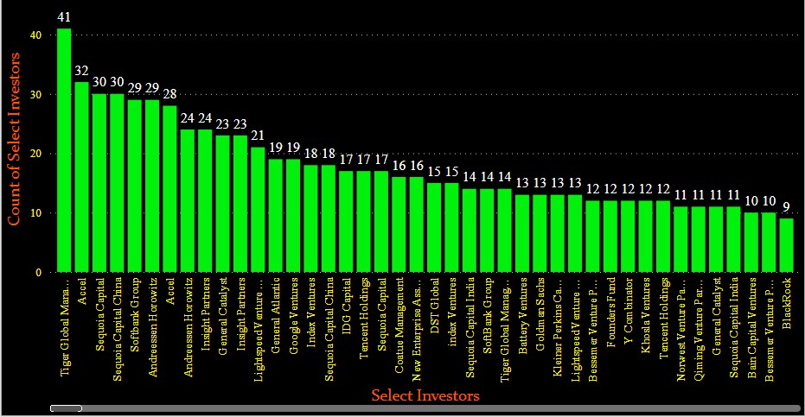
Modelling & Result
I used a clustered column chart to figure out which investor funded most of the unicorns.
This visual reveals that Tiger Global Management is the primary investor behind the majority of the unicorns

Slide 14
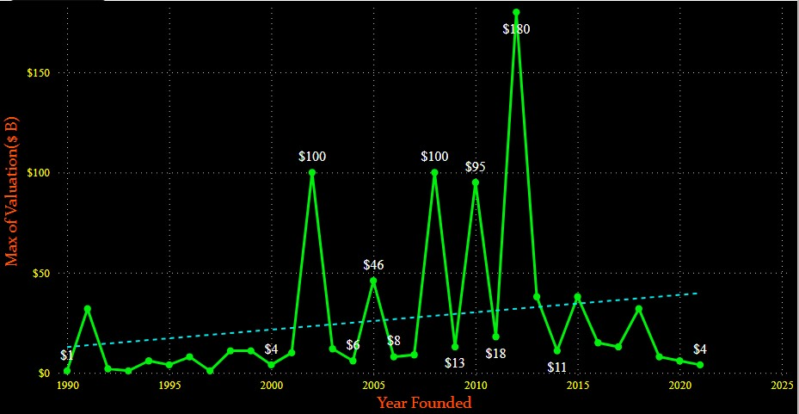
Modelling & Result
I employed a line chart to identify the year when an unicorn company achieved its highest valuation.
This visual indicates that 2012 was the year when an unicorn company achieved its highest valuation.

Slide 15
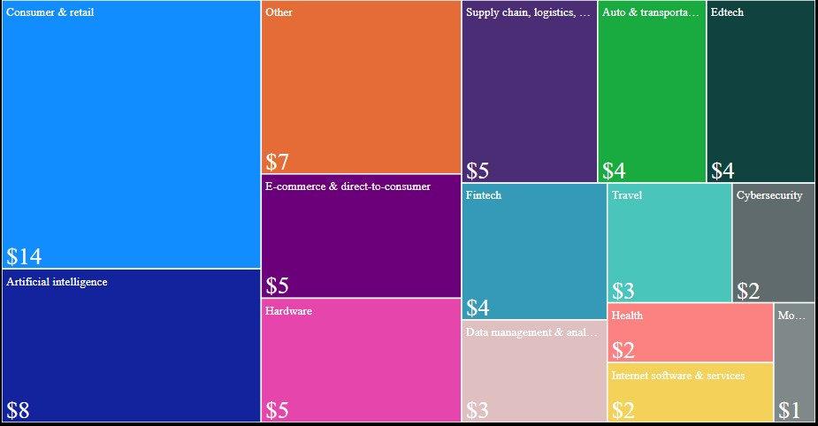
Modelling & Result
I utilized a treemap to ascertain which industry received the highest amount of funding.
This visual reveals that the consumer and retail industry received the highest amount of funding.

Slide 16
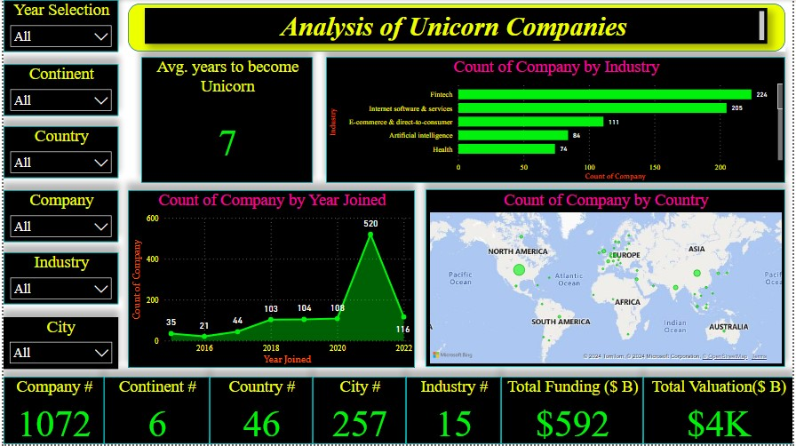
Dashboard 1

Slide 17
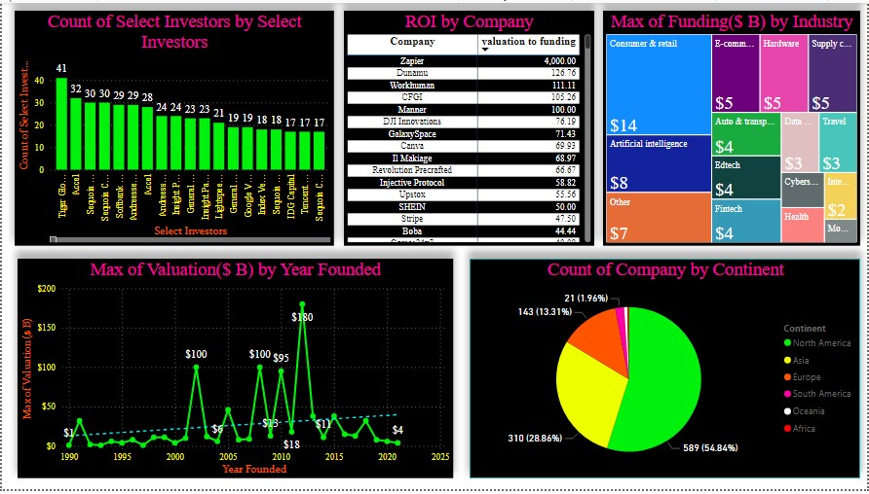
Modelling & Result

Slide 18

Conclusion
The project aimed to analyze unicorn companies using Power BI, covering various attributes such as company details, funding, industry, and more.
It progressed through four key stages: data collection and preprocessing, DAX functions and basic visualization, advanced visualization, and formatting/testing.
Through these stages, the project successfully extracted insights and provided valuable information about unicorn companies, their funding, industry trends, and more.
The project involved utilizing various visualization techniques such as stacked column charts, map visuals, line charts, treemaps, and clustered column charts to analyze different aspects of unicorn companies.
The use of Power BI facilitated the creation of interactive and visually appealing dashboards, enabling stakeholders to explore and understand the data effectively.

Slide 19


Notes:
Thank You !!

